Slide 1

Theorist Gallery
NURS608 Philosophical and Critical Foundations in Nursing- Athabasca University
February 28, 2023

Slide 2
Comparing Nursing Theories
Neuman Systems Model and Roy’s Adaptation Model

Slide 3
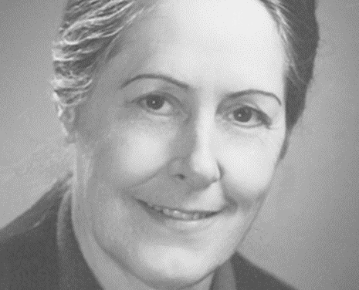
Dr. Betty Neuman
Betty Neuman was born in Ohio in 1924 where she completed her initial nursing education in 1947
Neuman moved to California and earned her baccalaureate degree in public health and psychology in 1957
Neuman earned her Masters in mental health and public health consultation in 1966, and then completed her doctoral degree in clinical psychology in 1985
Neuman developed the Neuman Systems Model in the 1970s
The model was initially created as a teaching tool to assist students in understanding the impact of patients' variables beyond the context of the medical model

Slide 4
Overview of Theory
The model is based on general system’s theory and can be applied to individuals, groups, populations, and social issues.
Major influences of the model come from Dr. Neuman’s own philosophical beliefs and expertise, gestalt theory (descriptions of homeostasis), Marxist philosophy (parts are viewed in relation to the whole system), Chardrin’s philosophy (of the whole person), Selye’s definition of stress, and Caplan’s (definitions of levels of prevention).
Wholistic approach → the client is more than the sum of their parts
The client is an open system in relationship to internal and external environmental stressors where the lines of defense and resistance work to protect the basic structure which is common to all.
The nurse creates linkages among the client, environment, health, and nursing.

Slide 5
Concepts
Person (Client System)
A composite of physiological, psychological, sociocultural, developmental and spiritual variables in interaction with the internal and external environment. Represented by a central structure, lines of defense, and lines of resistance.
Environment
All internal and external factors influences surrounding the client system. The environments include the internal, external, and the created environment.
Health
viewed as optimal system stability and viewed on a continuum of wellness to illness.
Nursing
Concerned with the whole person (client system), all potential stressors, and prevention as intervention (primary, secondary, and tertiary prevention). Uses the nursing process to guide care.

Slide 6
Assumptions
Nursing is concerned with the whole system
Responses of stressors are relative to each unique client
The nurse works with the client to achieve their optimal wellness
Outcomes are dependent the accuracy and comprehensiveness of the assessment
Collaborative process between the client and the nurse to guide intervention-as-prevention to retain, attain, and maintain health
Operationalization of the nursing process to set goals and evaluate outcomes

Slide 7
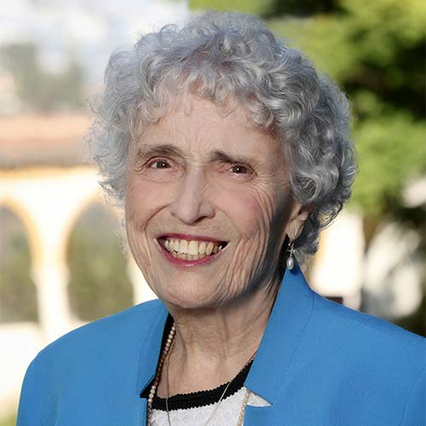
Sister Callista Roy
Born in 1939 in Los Angeles California
Earned a baccalaureate nursing degree in 1963 and master’s degree in nursing in 1966.
1977 - earned a doctorate in sociology
Roy developed the central concepts of her model while a graduate student at the University of California after being challenged by Dorothy Johnson to develop a conceptual model for nursing.

Slide 8
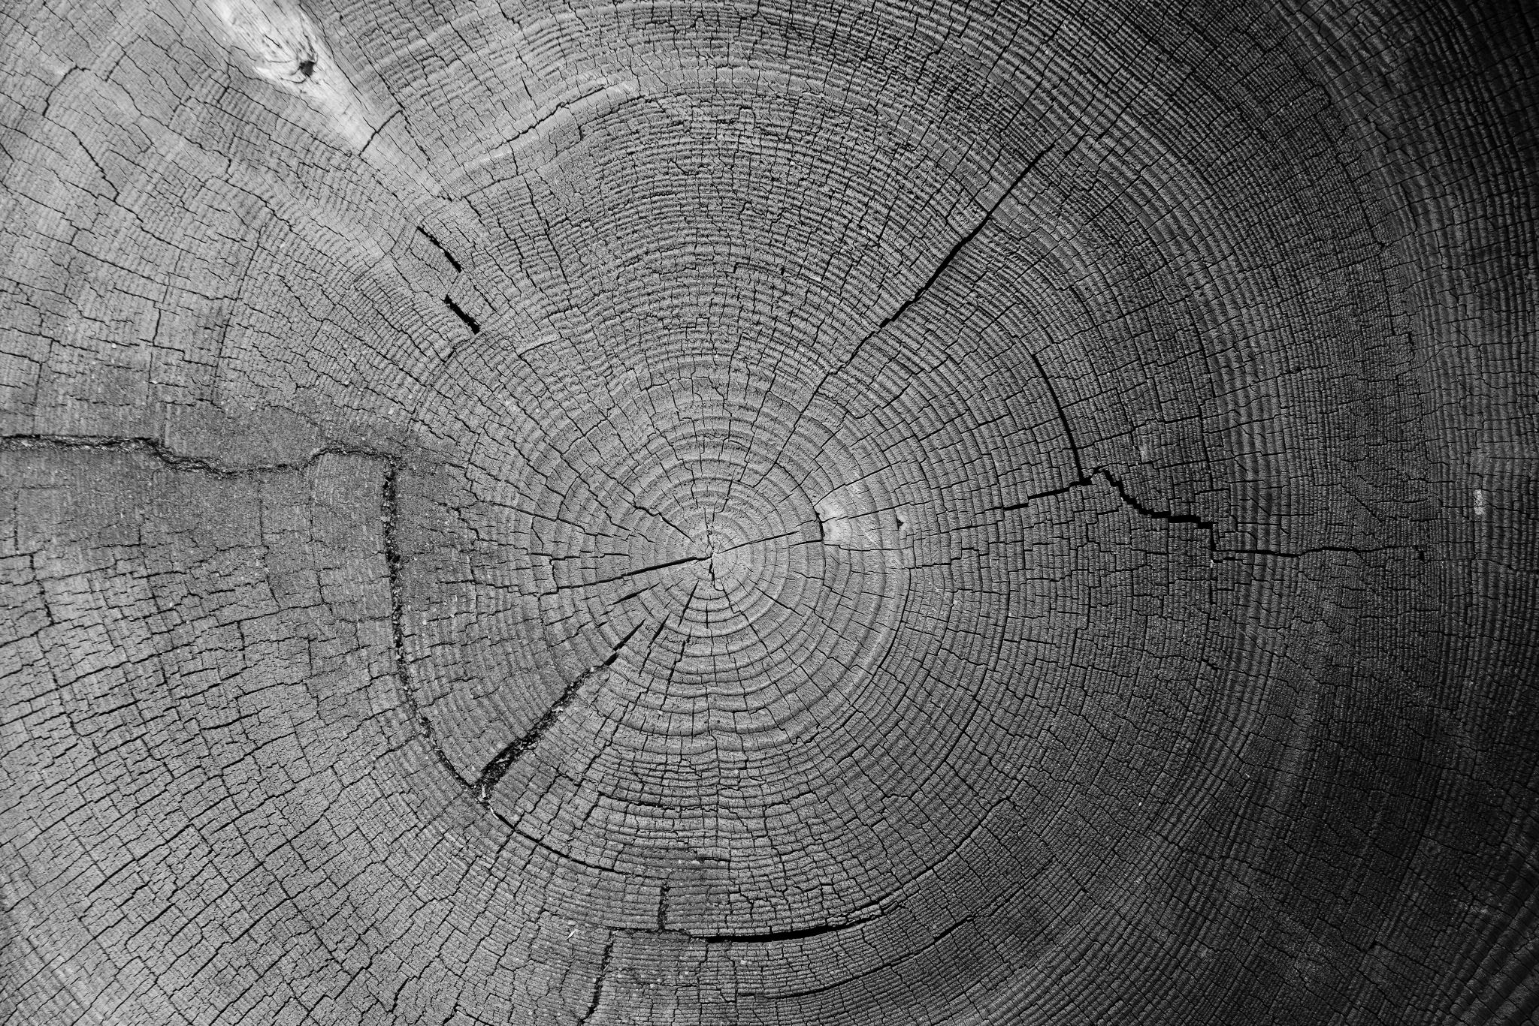
Theory Overview
Major influences of the theory: Harry Helson’s adaptation theory, Rapoport’s definition of systems and concepts from Lazarus and Selye
Systems theory
The client is viewed holistically and as an adaptive system in constant interaction with the internal and external environments.
Adaptation leads to optimal health and well-being.

Slide 9
Concepts
Person
Holistic, adaptive systems. They are bio-pyscho-social beings in constant interaction with their environments. The client uses innate and learned mechanisms to adapt. Include individuals, groups, families, organizations, communities and society as a whole.
Environment
All conditions and circumstances and influences surrounding and affecting the client development and behaviour. The environment stimulates a system response.
Health
Health and illness can coexist; health is a reflection of adaptation of the client in interaction with their environment. Process of promoting psychological, physiological, and social integrity.
Nursing
Concerned with the promotion of adaptation of individuals and groups in each of the four adaptive modes, thus contributing to health, quality of life, and dying with dignity by assessing behaviours and factors that influence adaptive abilities and intervening to enhance environmental factors.

Slide 10
Assumptions
The person is a bio-psycho-social binging. The client is viewed holistically and as an adaptive system in constant interaction with the internal and external environments.
To cope, the person uses both innate and learned mechanisms which are biologic, psychological and social in origin.
Persons must adapt to maintain health.
The person has 4 modes of adaptation: physiologic needs, self-concept needs, role-function, and inter-dependence.

Slide 11
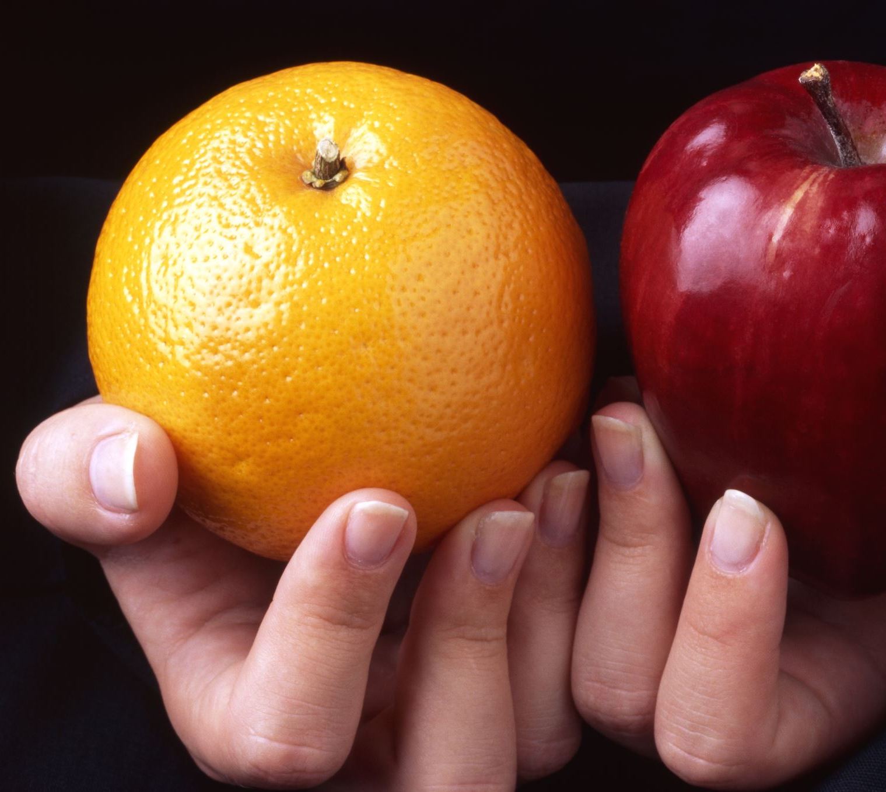
Comparisons
Both view the client holistically in constant interaction with their internal and external environments.
Both utilize information gained from assessment to guide nursing interventions facilitated by the nursing process
Both theories can be applied broadly to individuals, groups, communities and society
Health is seen on a continuum – when needs are met, optimal system stability/adaptation occur, when needs are not met, illness or death may result
Both have broad applicability in many practice settings.
Contrasts
Neuman's theory is focused on strengthening reactions to stress through 3 levels of nursing intervention (primary, secondary, and tertiary) to assist the client to retain, attain, or maintain health.
Roy’s theory is concerned with client adaption to an external stimulus which allows the client to cope.

Slide 12
Practice Scenario
Grade 8 teacher identified poor student coping skills related to stress in the classroom due to return to in-person learning and struggles academically as a result of previous online learning. The teacher also identified several students within the group who may be experiencing higher levels of difficulty coping demonstrated by body image concerns and not eating enough to nutritionally maintain health.

Slide 13
Practice Scenario Responses Neuman Systems Model
Group variables identified: psychological, physiological, and developmental
Internal environment: students are not adjusting well to return to in-person schooling but have expressed to their teacher they want to do well in school as they are going into high school next year.
External environment – the students have school staff who are supportive and concerned for them and want to see them succeed.
Created environment: the client (individuals within the group) can alter their created environment by learning coping mechanisms that can assist them in perceiving stressors differently and as manageable.
Group assessment with the teacher to determine mutually agreed upon interventions to retain, maintain, and attain wellness
Proposed Interventions:
Primary prevention interventions
  Education program for stress management techniques
  Enhances the lines flexible lines of defense
Secondary prevention interventions:
  Work with the teacher to identify students who may be in crisis and need further support
  Assist the teacher in facilitating opportunities for students to practice coping techniques in the classroom and share techniques with student families
  Strengthens normal lines of defense
Tertiary prevention interventions:
  Referral to community supports
  Facilitates the opportunity for reconstitution and regaining system stability

Slide 14
Practice Scenario Responses:
Roy’s Adaptation Model
Roy would assess and categorize the stimuli for the behaviours being exhibited by the clients. Goals would be set to promote adaptation and interventions would be aimed at changing stimuli or strengthening adaptation processes.
In this case scenario, the nurse would address the multiple issues in the classroom in collaboration with the teacher and based on an assessment completed with the students.
In this scenario, the nurse identified self-concept mode and physiological mode behaviours which require intervention.
Physiological Mode – interventions are targeted to physiological integrity and referral can be made to community resources to support mental health and nutritional needs of the students who are mal-adapting to stimuli.
Self-Concept Mode - The nurse can assist in strengthening the students’ self-concept mode through interventions targeted at building self-esteem and self-belief in their ability to cope when experiencing stimuli that cause stress and coping mechanisms targeted to stress management techniques.

Slide 15
References
Gunter Lawson, T., & . (2018). Systems Model. In (Ed.), Nursing theorists and their work (9th ed., pp. 231–248). Elsevier.
Masters, K. (2015). Nursing theories: A framework for professional practice. Jones & Bartlett Learning.
Neuman, B., & Fawcett, J. (2011). The neuman systems model (5th edition) (5th ed.). Pearson.
Phillips, K. D., & Harris, R. (2018). Adaptation Model. In Nursing theorists and their work (pp. 249–272). essay, Elsevier.

